Slide 1

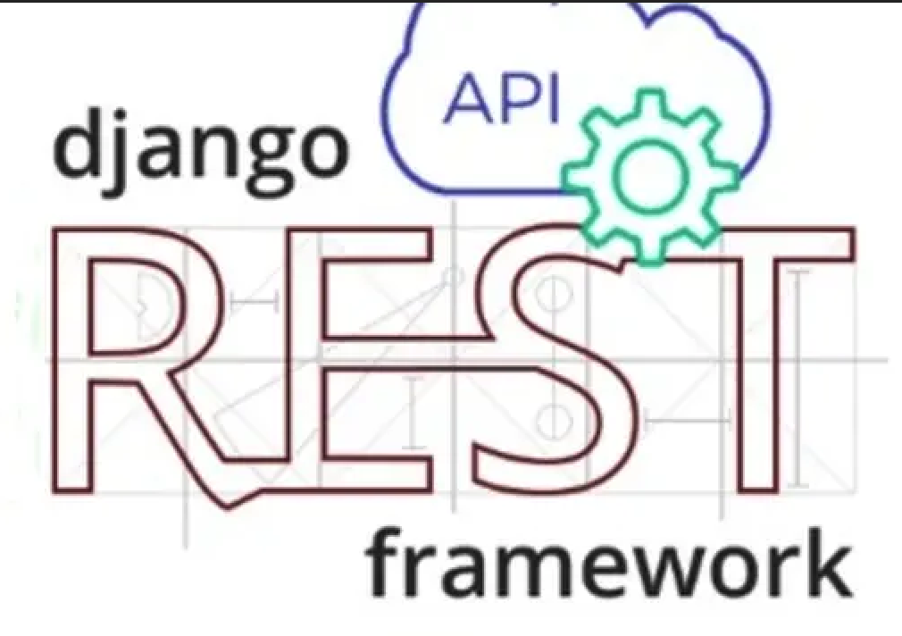
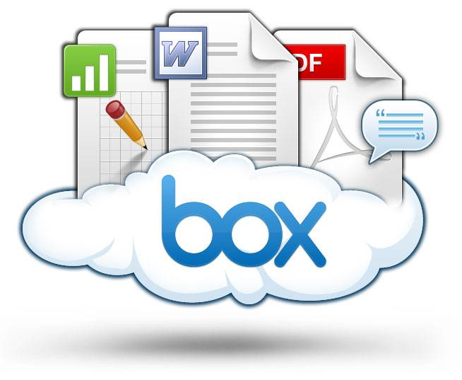
Django Rest Framework
Swaranjali Ingale
(Software developer @ Box)

Slide 2
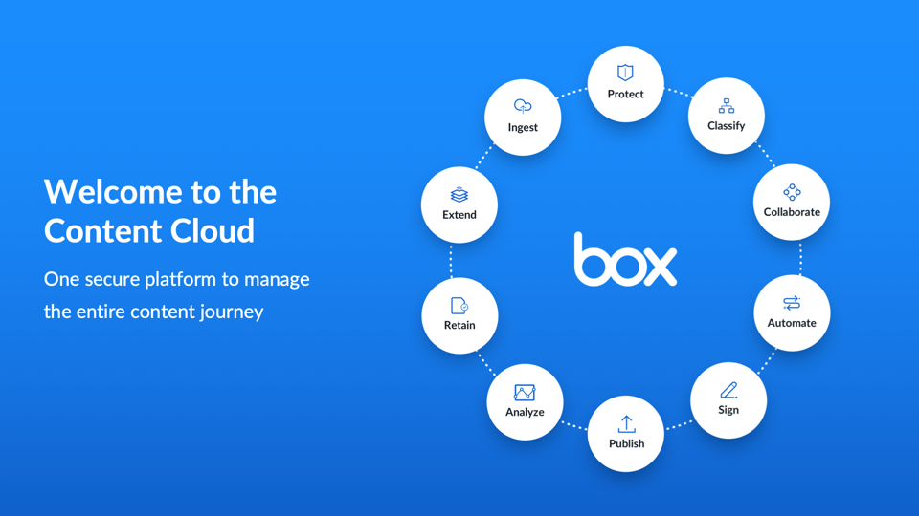
One secure platform for all the content
Easy collaboration with anyone, anywhere
Unlimited signatures at no added cost
Accelerate workflows
Protect your content

Slide 3
AGENDA
/ What is an API?
/ What are CRUD operations?
/ What is Django?
/ What is Django Rest Framework?
/When and why to use Django Rest Framework?
/Serialization
/Coding

Slide 4
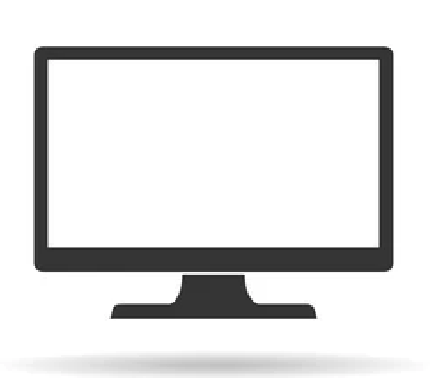

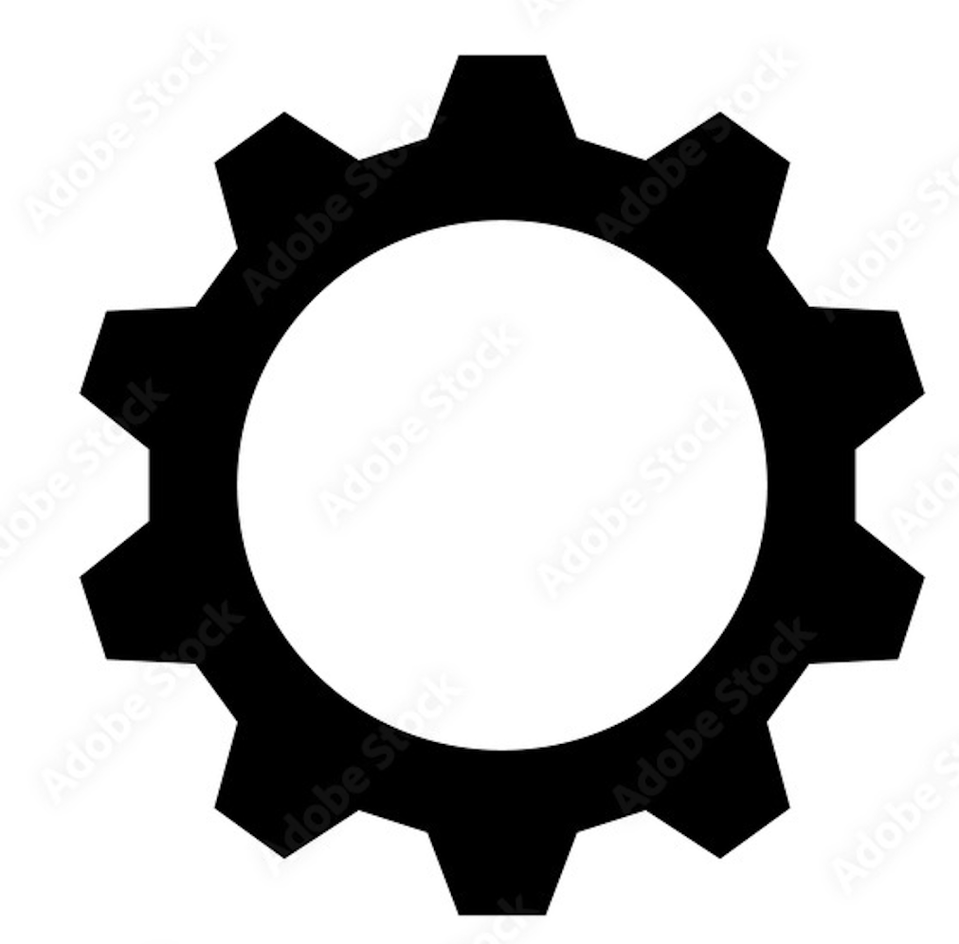
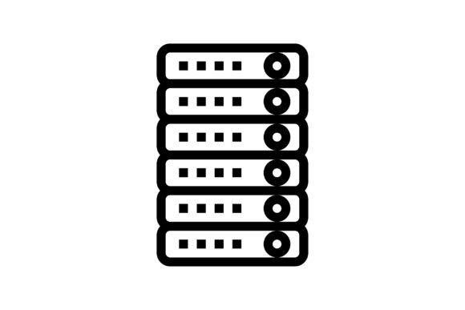
What is an API?(Application Programming Interface)
API’s are simply mechanisms that enable two software components to talk to each other.
Server
Client
Internet
API

Slide 5
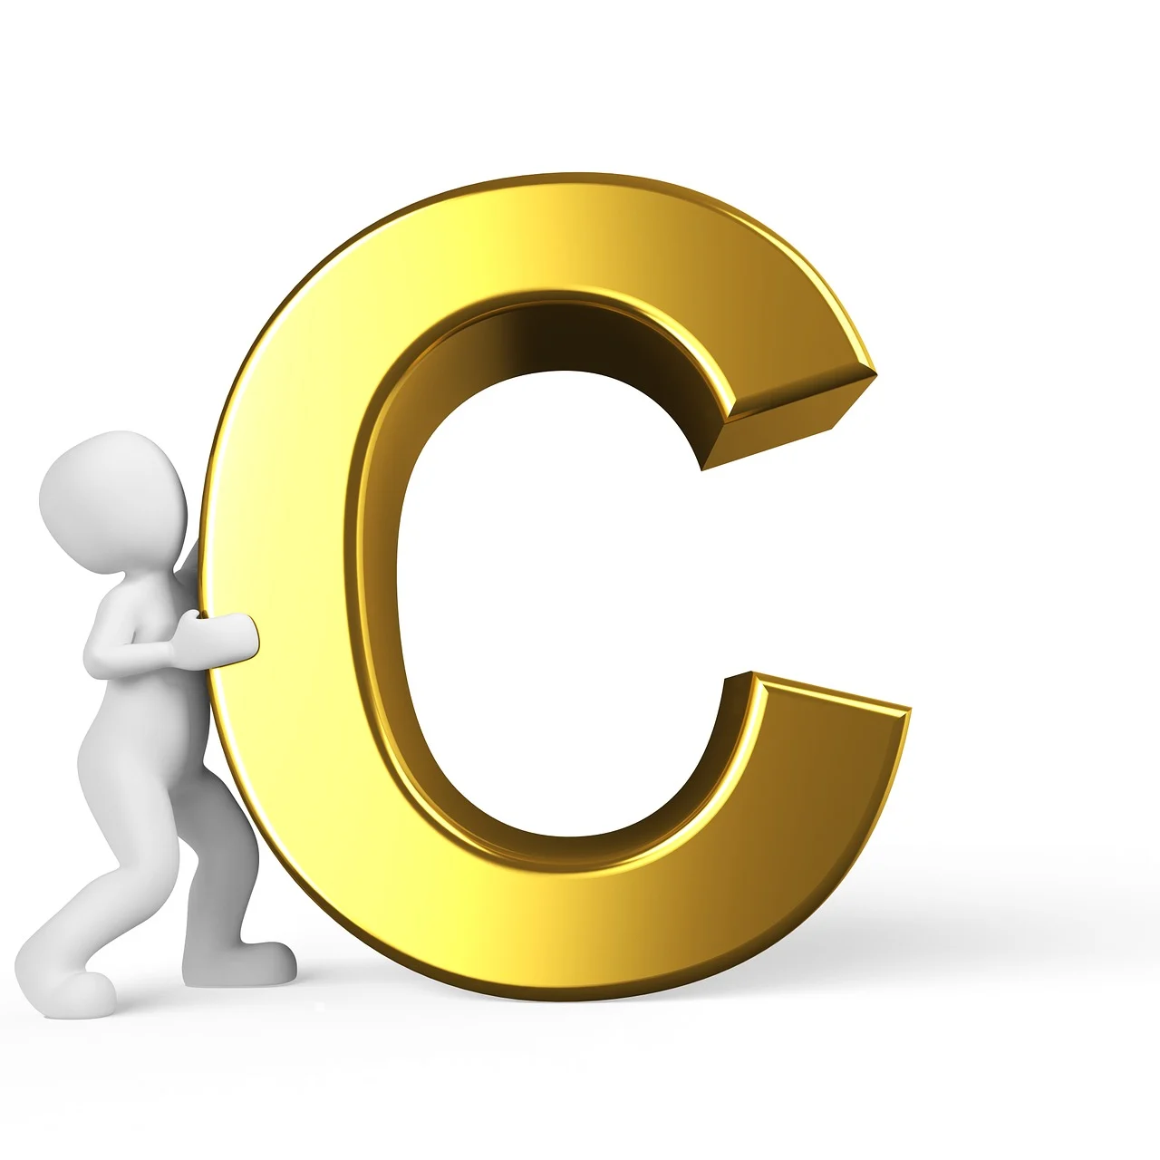
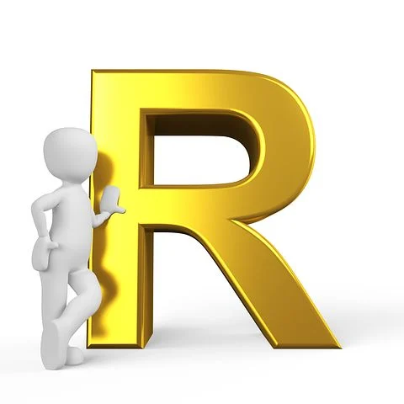

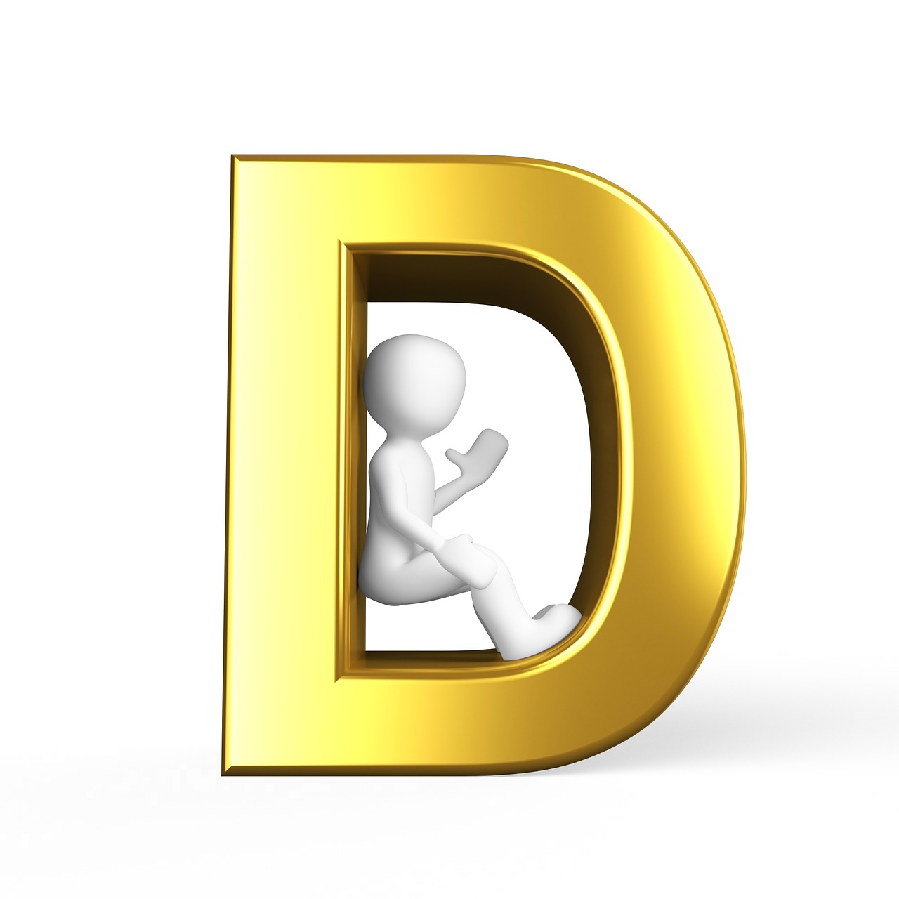
What is CRUD?
Process of creating a record or entity in the database. Eg: creating new user.
HTTP Method => POST
Process of retrieving information from the database. Eg: user account information.
HTTP Method => GET
Process of modifying information in the database. Eg: updating user account.
HTTP Method => PUT/PATCH
Process of deleting a record entity from a database. Eg: deleting user account.
HTTP Method => DELETE

Slide 6
What is DJANGO?
Django is a high-level Python web development framework.
Django follows MVT pattern.
Django supports ORM (Object Relational Mapping).

Slide 7
What is DJANGO REST FRAMEWORK?
Django is an API framework designed for building RESTful APIs with Django.
Request
URL Patterns
Serializer
Response
Views
Database
Models

Slide 8
When and Why to use DRF?
If you are using Django as your web framework and you need to write a REST API, the Django REST framework is the default choice to get the job done.
It also comes with many features out of the box to simplify API development:
A web browsable API – where you can browse and interact with your API.
Built in authentication and authorization, including packages for OAuth1a and OAuth2.
Built in serialization for Django models and other data, with input validation.
Easy backend filtering and sorting of data.
Support for easy pagination of results.
Support for versioning.
Support for API schemas and documentation.
Lots of documentation and support of a large community.

Slide 9
What is Serialization?
Serializers are responsible for converting objects into data types understandable by JavaScript and front-end frameworks.
The process of converting complex data types such as querysets and model instances to native python datatypes is called serialization in DRF.
Serializers also provide deserialization, allowing parsed data to be converted back into complex types, after first validating the incoming data.

Slide 10
THANK YOU !

